Slide 1
Raspberry Pi Workshop
University Edition
30.01.2018
Notes:
Are your classroom colors different than what you see in this template? That’s OK! Click on Design -> Variants (the down arrow) -> Pick the color scheme that works for you!
Feel free to change any “You will…” and “I will…” statements to ensure they align with your classroom procedures and rules!

Slide 2
Backstory – University limitations
WiFi uses WPA2-Entrprise (identity+password) vs. WPA2-PSK (pre-shared password)
WiFi has no peer-to-peer connection
No ethernet

Slide 3




Backstory – University limitations

Slide 4
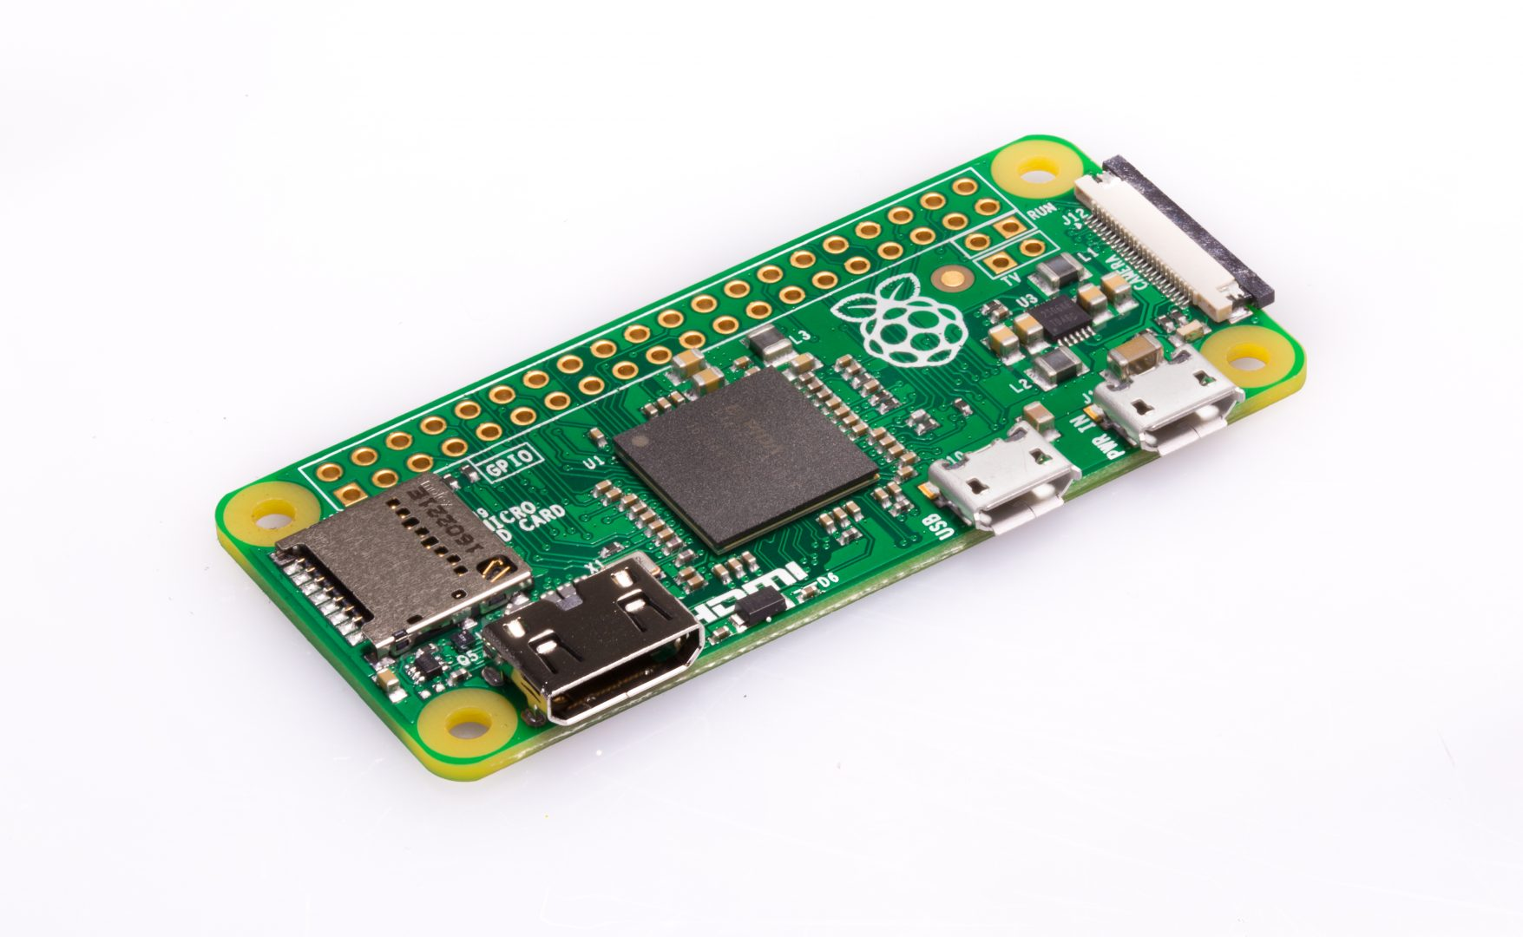
Solution
£9.30

Slide 5
Contents
Getting started
Raspberry Pi
Linux
SSH
Flashing and configuring
Connecting to the Pi
Setting up the Pi
Profit!

Slide 6
Getting started

Slide 7

Raspberry Pi
The Raspberry Pi is a series of small single-board computers developed in the United Kingdom by the Raspberry Pi Foundation to promote teaching of basic computer science in schools and in developing countries. The original model became far more popular than anticipated, selling outside its target market for uses such as robotics.
Powered by an (old) ARM processor
Includes WiFi, Ethernet, Bluetooth, Audio IO, GPIO, HDMI, USB, CSI, DSI (Pi3B+)
Addon hardware and tutorials flood the internet!

Slide 8

Linux
Linux is a family of free and open-source software operating systems based on the Linux kernel an operating system kernel first released on September 17, 1991 by Linus Torvalds. Linux is typically packaged in a Linux distribution (or distro for short).
Distributions include the Linux kernel and supporting system software and libraries, many of which are provided by the GNU Project.
Famous distros: Ubuntu, Raspbian, Fedora

Slide 9

Linus

Slide 10
SSH (Secure Shell)
Secure Shell (SSH) is a cryptographic network protocol for operating network services securely over an unsecured network. Typical applications include remote command-line login and remote command execution, but any network service can be secured with SSH.
Included in Linux, macOS, and now Windows 10!

Slide 11
Flashing and configuring
Highly recommended distro – Raspbian
https://www.raspberrypi.org/downloads/raspbian/
Highly recommended flash tool – BalenaEtcher
https://www.balena.io/etcher/
Enable SSH
/boot/ssh
Setup Wi-Fi
/boot/wpa_supplicant.conf

Slide 12
Connecting to the Pi

Slide 13
Connecting to the Pi
Ethernet over USB
Easiest method
Not reliable on Windows :(
WiFi hotspot
Must pay attention to 2.4GHz vs 5GHz
Android hotspot (sharing mobile data)
Android repeater (requires root)
https://github.com/Mygod/VPNHotspot
Laptop

Slide 14
Setting up the Pi

Slide 15
Setting up the Pi
Follow on-screen :)
Usage doubts? https://explainshell.com/

Slide 16
Profit

